Slide 1
Reproducibility in an Office World
Noam Ross
New York R Conference
May 2019

Slide 2


@EcoHealthNYC
@rOpenSci

Slide 3
The Two Realms of Workflows
Programmatic
Linear
Centralized
Automated
Interactive
Iterative
Decentralized
Manual

Slide 4



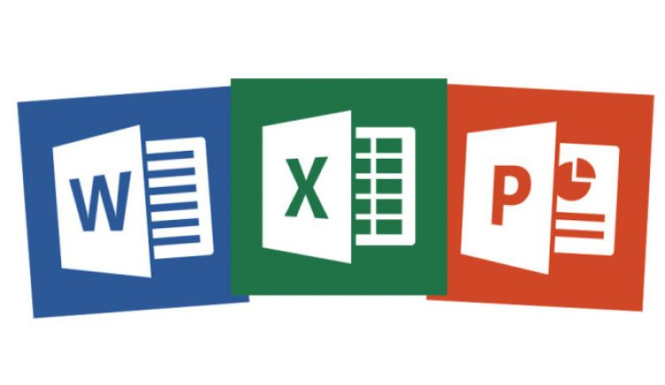
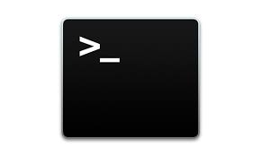


The Two Realms of Workflows

Slide 5
Valley of Heartbreak

Slide 6
Avoiding the Valley of Heartbreak
Reduce your round-trips
Make them as short as possible!

Slide 7
Web and programmatic outputs
Documents and further iterated outputs

Slide 8
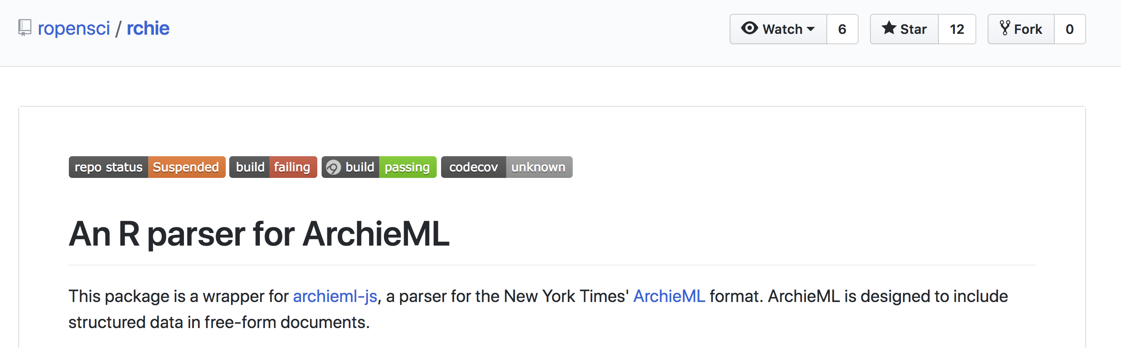

“ Structured text, for an unstructured world.”

Slide 9
Web and programmatic outputs
Documents and further iterated outputs

Slide 10
The Officeverse
officer
rvg
flextable
officedown
mschart
rmarkdown
pandoc
or, the gohelverse:
David Gohel (@DavidGohel)
Notes:
mostly by David Gohel

Slide 12
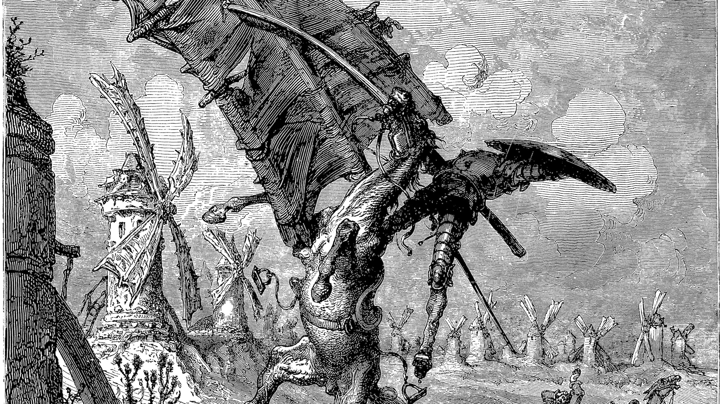

Slide 13
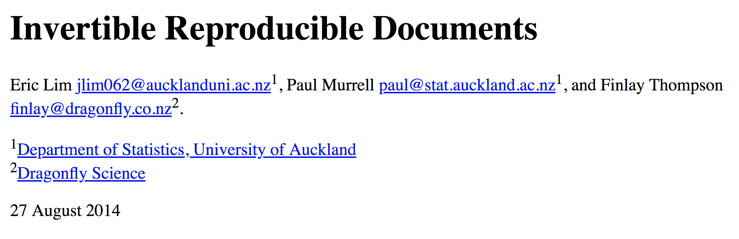
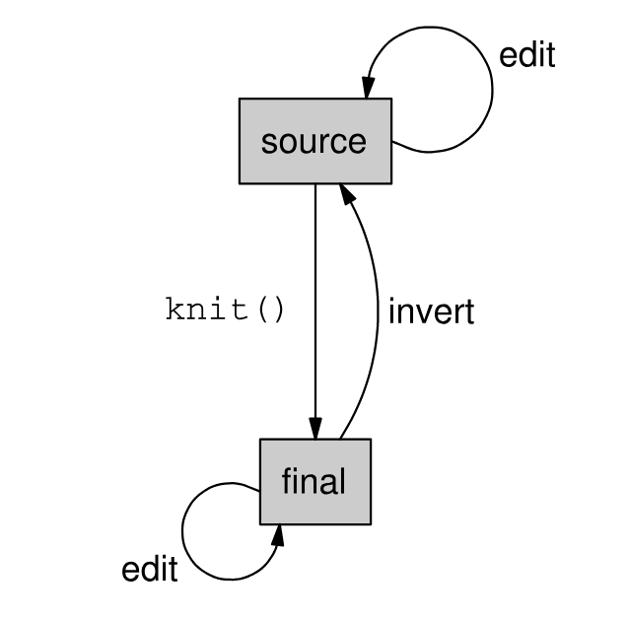

Slide 14
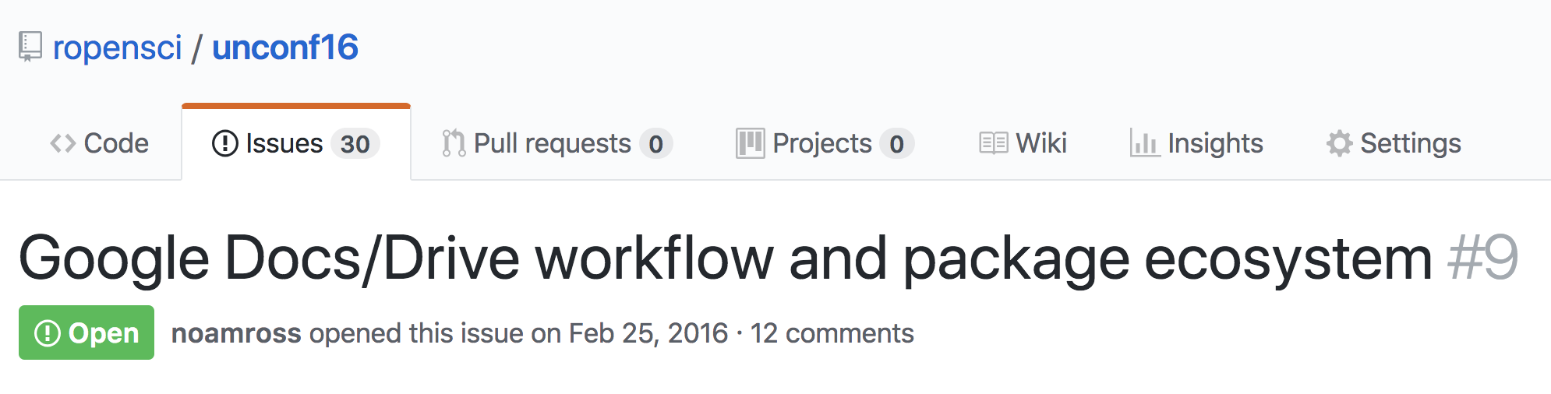
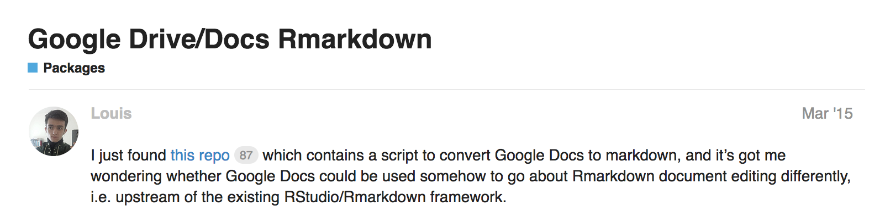
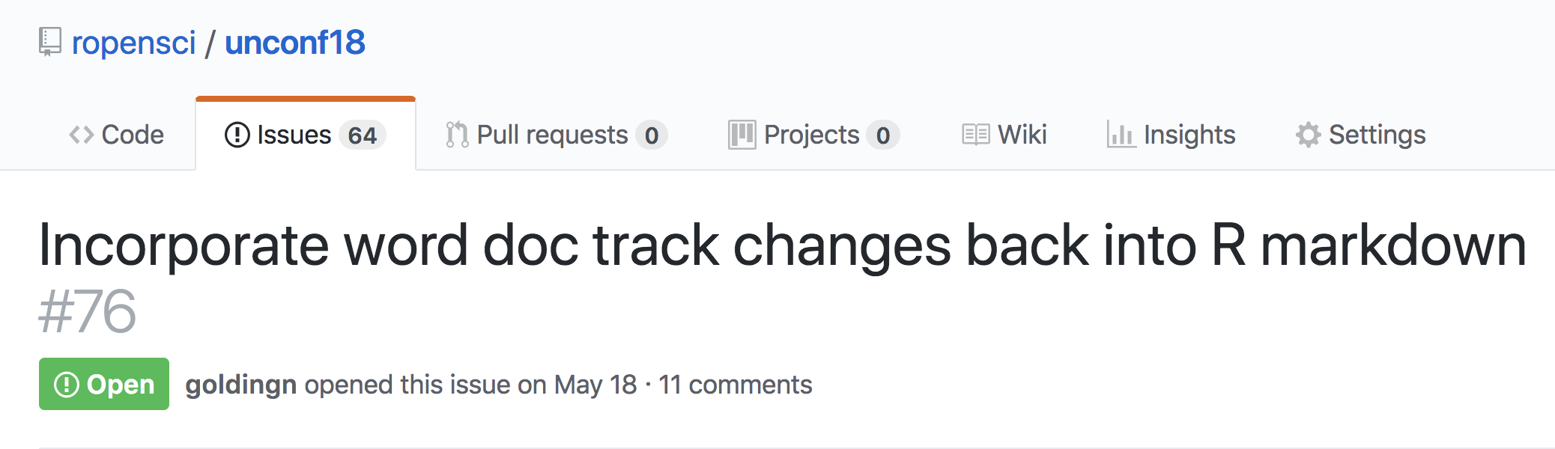
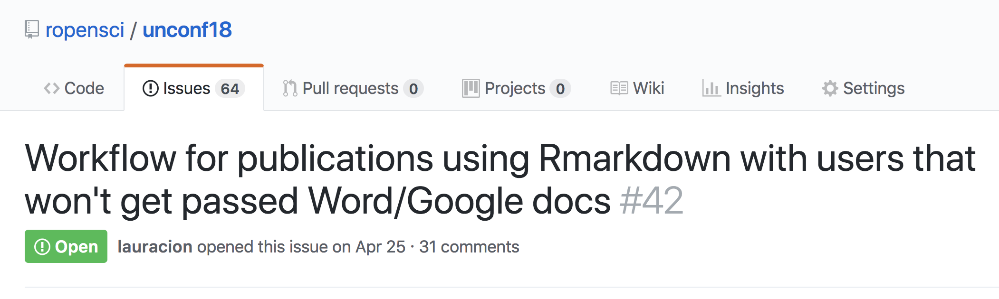

Slide 15
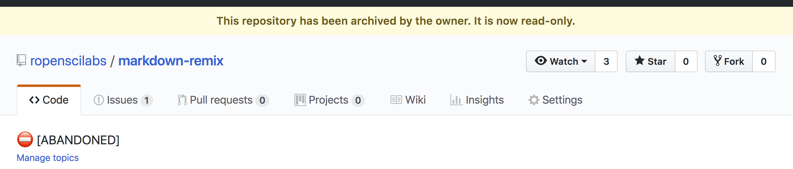
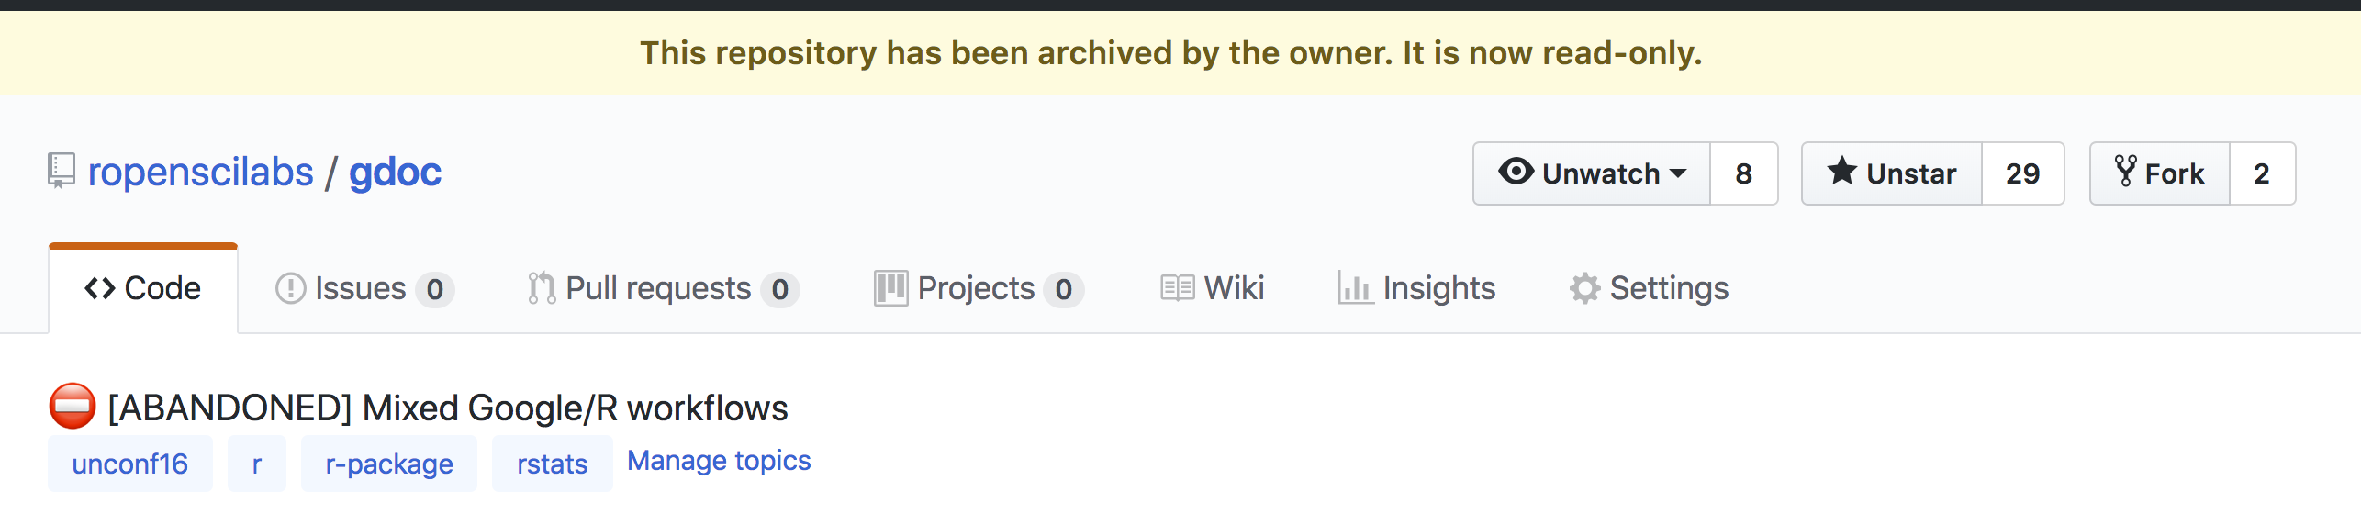

Slide 16
{ redoc }
📦
Reversible Reproducible Documents
noamross.github.io/redoc

Slide 17
The road ahead for redoc
officedown and other format integration
robustness and more edge-case testing
citations?
Google Docs support?
noamross.github.io/redoc/CONTRIBUTING.html

Slide 18
Thank you!
And thanks to:
Yihui Xie+ (knitr, rmarkdown)
David Gohel (officer, officedown)
John Macfarlane (pandoc)
Brodie Gaslam (diffobj)
…and many more

